Slide 1
Topic 03a Network Protocols
ST1010 Network Fundamentals

Slide 2
Objectives
Define what are network protocols
Explain IPv4 and IPv6 addressing
Describe Packets
Describe ICMP Protocol
Describe TCP Protocol and 3-way handshake
Describe Hypertext Transfer Protocol (HTTP)
Ports
Describe File Transfer Protocol (FTP)

Slide 3
What are network protocols?
Communication between people need to follow some protocol. (otherwise everyone will be talking in different languages at the same time and no one is listening!)
Communication between devices also follow protocols, known as network protocols
Network protocols set out rules on how devices communicate with one another

Slide 4
The OSI Model and the TCP Stack

Slide 5

TCP/IP’s Layered Architecture
Example of how the layers work together:
You start your Web browser and your home page is http://www.cengage.com
The web browser formats a request for your home page by using the Application layer protocol HTTP
The request looks something like:
The unit of information the Application layer works with is simply called “data”
Notes:
TCP/IP’s Layered Architecture
Example of how the layers work together:
You start your Web browser and your home page is http://www.cengage.com
The web browser formats a request for your home page by using the Application layer protocol HTTP
The request looks something like:
The unit of information the Application layer works with is simply called “data”

Slide 6

TCP/IP’s Layered Architecture
Example continued:
The Application-layer protocol HTTP passes the request down to the Transport-layer protocol (TCP)
TCP adds a header to the request that looks like:
The unit of information the Transport layer works with is called a segment
TCP passes the segment to the Internetwork layer protocol (IP)
Notes:
TCP/IP’s Layered Architecture
Example continued:
The Application-layer protocol HTTP passes the request down to the Transport-layer protocol (TCP)
TCP adds a header to the request that looks like:
The unit of information the Transport layer works with is called a segment
TCP passes the segment to the Internetwork layer protocol (IP)

Slide 7

TCP/IP’s Layered Architecture
Example continued:
IP places its header on the segment:
The unit of information is now called a packet
The packet is passed down to the Network access layer, where the NIC operates
A frame header and trailer are added
The frame is delivered to the network medium as bits
on its way to the www.cengage.com server
The web server processes it and returns a Web page
Notes:
TCP/IP’s Layered Architecture
Example continued:
IP places its header on the segment:
The unit of information is now called a packet
The packet is passed down to the Network access layer, where the NIC operates
A frame header and trailer are added
The frame is delivered to the network medium as bits
on its way to the www.cengage.com server
The web server processes it and returns a Web page

Slide 8
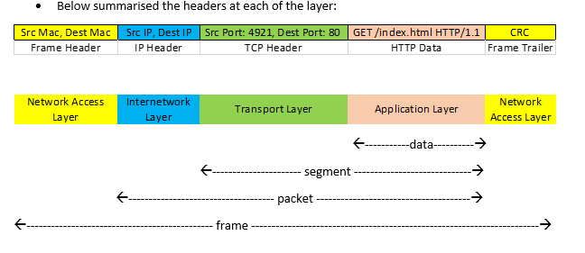

Slide 9
MAC address
Media Access Control address
Unique hardware (physical) address assigned to network interface cards
Assigned by the vendor of the network card
Represented as 6 groups of 2 hexadecimal digits
01:D6:A7:F0:38:95

Slide 10
Ethernet frame (Layer 2)
Data Link Layer – transmits frames between adjacent nodes
For data travelling on Ethernet cables.
Preamble
(7 bytes)
Start of frame delimiter
(1 byte)
Destination MAC address
(6 bytes)
Source MAC address
(6 bytes)
Length
(2 bytes)
Data
Frame Check Sequence (4 bytes)
802.3 Ethernet frame

Slide 11
IP addressing v4 and v6
IPv4 uses 32-bit (four-byte or four octets) addresses, which limits the address space to about 4 billion addresses
192.168.1.100
IPv6 will use 128-bit addresses, which supports about 300 trillion trillion trillion addresses
2001:0db8:8fa3:dc94:1a2e:a370:7334:7337
One or more consecutive sections of all zeros in an IPv6 address can be replaced by a double colon
Eg. 2001:0f58:0:0:0:0:1986:202 can become 2001:0f58::1986:202

Slide 12
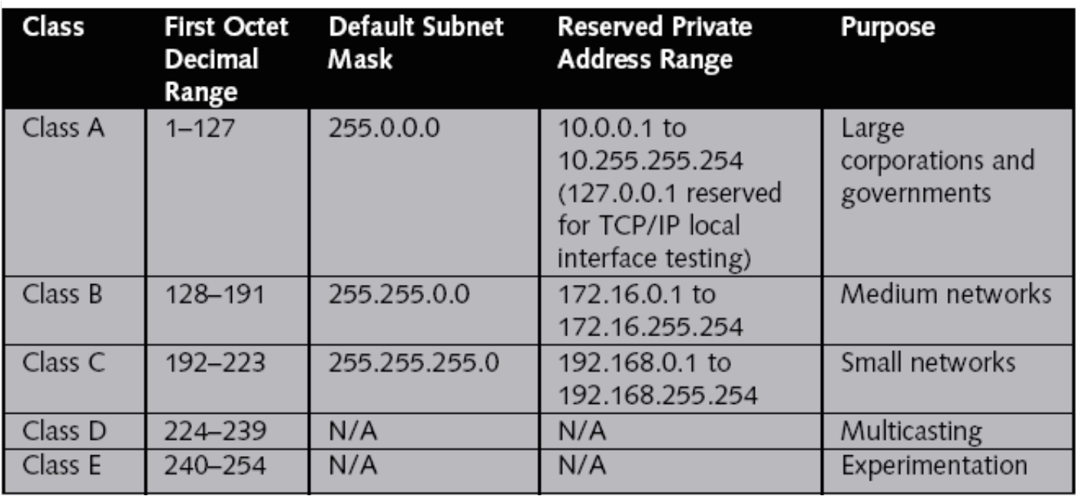
IP classes
Packets that begin with 127 in the first octet are used for network testing
Broadcast address generally end with a 255

Slide 13
Subnet mask
IP address components
Network address
Host address
Subnet mask
The Subnet mask determines which part of the address is for the network, and which part is for the host.
Subnet masks can be used to divide the network into subnetworks.

Slide 14
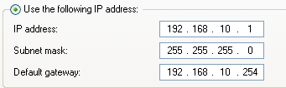
Subnet Mask
A subnet mask of 255.255.255.0 means the first three octets of the IP address is the network address “192.168.10”.
The last octet is the host address “1”.

Slide 15
Specifying the subnet masks
Classless Interdomain Routing (CIDR) notation
Eg. 192.168.1.0/24
Means the network 192.168.1.0 with a subnet mask of 255.255.255.0
Eg. 162.100.0.0/16
The network 162.100.0.0 with a subnet mask of 255.255.0.0
Explanation of Subnet masks
http://www.iplocation.net/tools/netmask.php

Slide 16
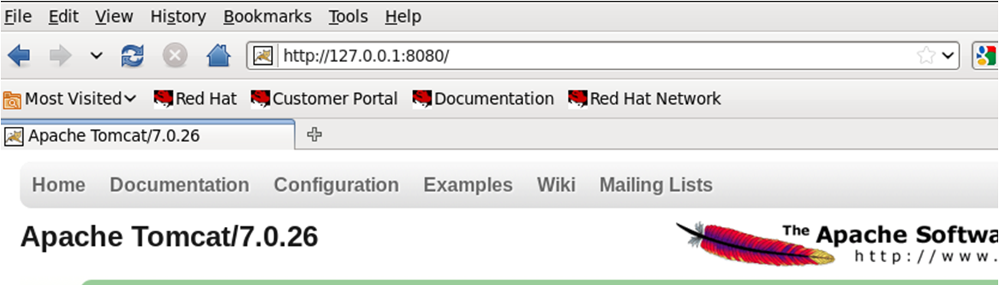
Loopback address
The hostname “localhost” or IP “127.0.0.1” refers to the local machine
Packet addressed to the loopback never leaves the system
Used for testing
Eg. After installing a web server, test that it is running by connecting to the loopback address

Slide 17
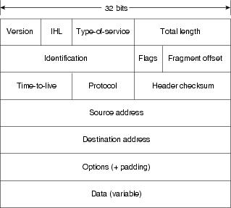
IP Packet (Layer 3)
Network Layer – controls transmission of packets along routers on network

Slide 18
TCP and UDP (Layer 4)
Transport Layer – provides transfer of data between end nodes
TCP – Transmission Control Protocol
Connection-oriented
Monitoring receipt of frames, re-send if necessary
Controls data flow
UDP – User Datagram Protocol
Connectionless
Does not guarantee packets will be received
No flow control

Slide 19
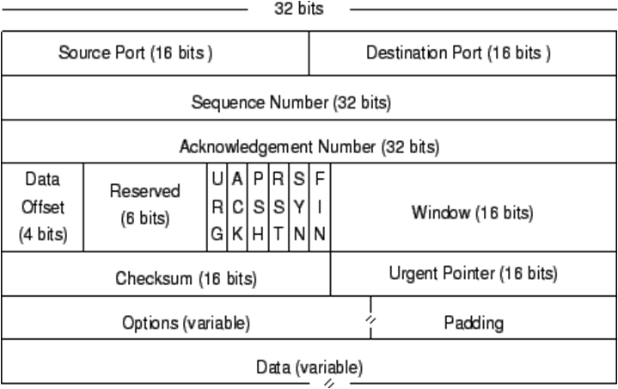
TCP Packet (Layer 4)

Slide 20
TCP Flags
Flags
URG (urgent)
ACK (acknowledge)
PSH (push function)
RST (reset the connection)
SYN (synchronize sequence numbers)
FIN (finished)
Request for Comments (RFC)
Document to describe standards for network protocols
TCP - RFC 793
www.ietf.org/rfc/rfc793.txt

Slide 21
UDP Headers
User Datagram Protocol (UDP): provides a transport service for IP
Considered unreliable because it is connectionless
UDP packet does not contain the sequence or acknowledgement numbers that enable TCP to guarantee delivery
Much faster than TCP (less overhead)
Used for broadcasting messages or for protocols that do not require the same level of service as TCP
Attackers can also scan for open UDP services
Common applications that use UDP : DNS. DHCP, SNMP

Slide 22
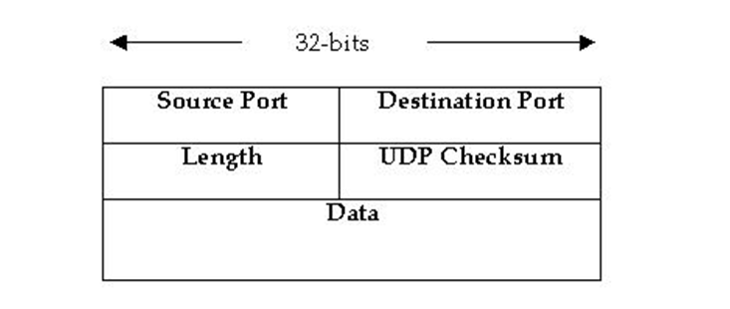
UDP Packet (Layer 4)

Slide 23
ICMP
Internet Control Message Protocol
Assists TCP/IP networks with troubleshooting communication problems
Can tell if another host is alive through a ping signal
Firewalls and packet filters may be used to block ICMP packets
Computer A
Computer B
ping request
ping response

Slide 24
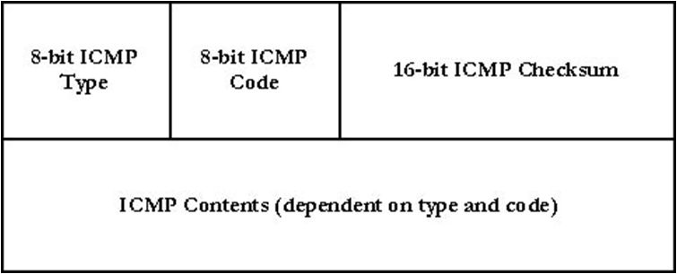
ICMP Payload
Some common ICMP type codes :
0 Echo Reply
3 Destination unreachable
7 Destination host unknown
8 Echo Request

Slide 25
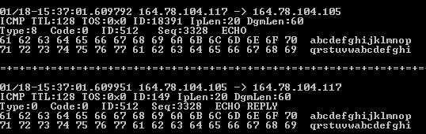
Ping Signatures
Signature – set of characteristics (pattern) used to define a type of network activity
Echo request Sequence Number
Echo reply Sequence Number

Slide 26
Time-To-Live (TTL)
The Time-To-Live (TTL) is a field in the IP packet
When a packet is created, the TTL is set to an initial value
As the packet travels on the Internet, each time it passes through a router, the TTL field is decremented
When the TTL reaches zero and the packet has not reached its destination yet, the router discards it and sends an ICMP packet back to the sender.
This prevents packets from staying in the Internet forever

Slide 27
Default TTLs
Different operating systems generally set different default TTL values for packets that they send
By looking at the initial TTL values of packets, we can sometimes guess the operating system of the source

Slide 28
Three-way handshake
TCP uses a 3-way handshake to establish a connection between 2 computers
Packet with SYN flag
Computer A
Computer B
Packet with SYN and
ACK flags
Packet with ACK flag

Slide 29
Three-way handshake used by TCP in establishing a communication session
A TCP session begins when a client sends a TCP synchronization (SYN) segment to the destination device, usually a server. A destination port number is specified, and a source port number is assigned dynamically.
When the server receives the SYN segment, it usually responds by sending one of two segments: an acknowledgment synchronization (ACK-SYN) segment or a reset connection (RST) segment.
If an RST segment is returned, the server refused the request to open a session, possibly because the destination port is unknown. If an ACK-SYN segment is returned, the client completes the 3-way handshake by sending ACK segment back to the server. The client is then ready to begin sending or requesting data

Slide 30
Hypertext Transfer Protocol (HTTP)
Protocol used to access data on the World Wide Web
Computer B
(Web Server)
Computer A
(Client)
Get web page request
Web page contents

Slide 31
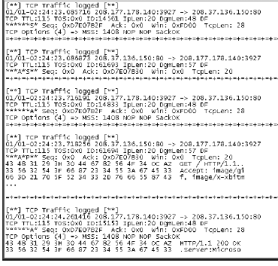
HTTP Signatures
Client (208.177.178.140) initiates connection to Server (208.37.136.150) on port 80, sends a SYN packet
Server responds with a SYN/ACK packet
Client sends an ACK packet to complete 3-way handshake
Client requests for web page from Server
Server sends web page

Slide 32
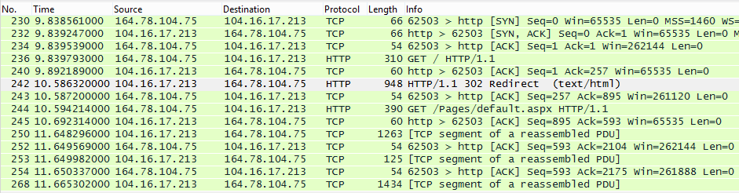
HTTP Signatures
Packet 230 : Client (164.78.104.75) initiates connection to Server (104.16.17.213) on port 80, sends a SYN packet
Packet 232 : Server responds with a SYN/ACK packet
Packet 234 : Client sends an ACK packet to complete 3-way handshake
Packet 236 : Client requests for web page from Server (using the HTTP GET method)
Packet 240 : Server acknowledges client’s request
Packet 242 : Server sends web page response (in this case, a redirect to another page
Packet 243 : Client acknowledges server’s response
Packet 244 : Client requests for redirected page (using HTTP GET method)
Subsequent packets : Server transmits the web page, breaking up the content in multiple packets, while Client regularly acknowledges receipt of packets so far

Slide 33



Why need HTTPS?
In normal HTTP, client web requests and server responses (webpages) are sent over the Internet in cleartext
GET www.sp.edu.sg
SP home page
User
Web Server
A hacker may be able to intercept the traffic and see what the user is doing

Slide 34
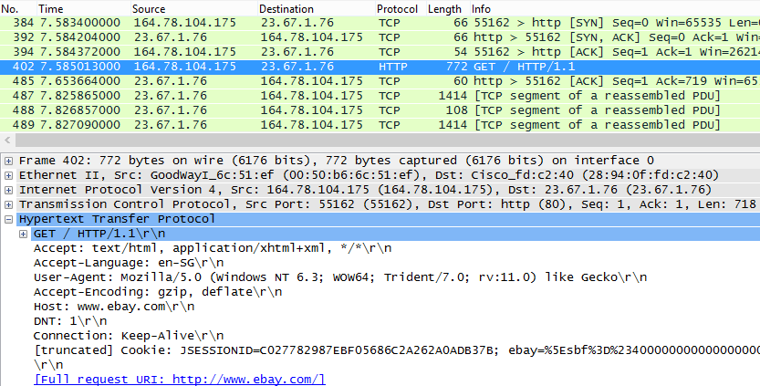
Why need HTTPS?
Anyone intercepting HTTP can see this data traffic
HTTP GET packet (request for webpage from server)
Host visited : www.ebay.com

Slide 35


HTTPS
To transport HTTP data securely over the Internet
HTTP over SSL (Secure Socket Layer), or HTTP over TLS (Transport Layer Security)
A session key is set up to encrypt traffic between user and web server
Anyone who intercepts the data will not be able to decrypt it
JAfk9HJSLLRFLLDFOE
PPO9873eklr8jJSS
User
Web Server

Slide 36
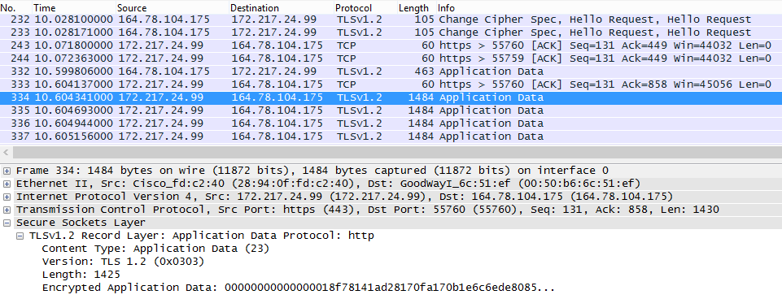
HTTPS
Anyone intercepting HTTPS will see encrypted data

Slide 37
TCP SEQ and ACK numbers
The TCP protocol uses the SEQ and ACK fields to check that all packets have been sent and received correctly
A SEQ number is randomly allocated to the SYN packet
SEQ is the sequence number given to the first data byte in a TCP packet
ACK contains the sequence number of the next packet expected to be received

Slide 38
SEQ and ACK : Simple example
COMPUTER A
COMPUTER B
SEQ : 100
ACK : 0
ACK is set to 101, which means Computer B expects the next packet from Computer A to have SEQ number of 101
SEQ : 300
ACK : 101
SEQ : 101
ACK : 301
SEQ : 301
ACK : 102

Slide 39
SEQ and ACK : Simplified Web site request
CLIENT
WEB SERVER
SYN
SEQ : 100
ACK : 0
SYN/ACK
SEQ : 300
ACK : 101
ACK
SEQ : 101
ACK : 301
ACK is increased to 141
(Server has received 40 bytes of data from Client and Server expects next packet from Client to have SEQ 141)
SEQ : 101
ACK : 301
“REQUEST
FOR WEB PAGE”
(40 bytes of data)
SEQ : 301
ACK : 141
WEB PAGE DATA
(200 bytes of data)

Slide 40
SEQ and ACK : Simplified Web site request
CLIENT
WEB SERVER
SEQ : 301
ACK : 141
WEB PAGE DATA
(200 bytes of data)
SEQ : 501
ACK : 141
WEB PAGE DATA
(200 bytes of data)
SEQ : 141
ACK : 701
RECEIVED
WEB PAGE
ACK is increased to 701
(Client has received 400 bytes of data from Server and Client expects next packet from Server to have SEQ 701)

Slide 41
TCP SEQ and ACK numbers
Don’t worry if you find it difficult to understand how the SEQ and ACK increase with the packets being sent and received. You just need to understand the below two points:
With the SEQ and ACK numbers, TCP can re-order packets that arrive out of sequence
With the SEQ and ACK numbers, TCP can tell if a packet is missing in transit and can re-send the packet

Slide 42
TCP and UDP Ports
A virtual channel to applications that are sending and receiving network data
Also called sockets
Port numbers start at 0 and go up to 65535
Well known port numbers
21, 20 File Transfer Protocol (FTP)
25 Simple Mail Transfer Protocol (SMTP)
80 Hypertext Transfer Protocol (HTTP)
443 Hypertext Transfer Protocol Secure (HTTPS)
Search the Internet for “Well known port numbers”

Slide 43
Netstat
Netstat can be used to display opened ports and current network connections
Sample output :
Active Connections
Proto Local Address Foreign Address State
TCP 0.0.0.0:135 0.0.0.0:0 LISTENING
TCP 0.0.0.0:443 0.0.0.0:0 LISTENING
TCP 0.0.0.0:445 0.0.0.0:0 LISTENING
TCP 0.0.0.0:1025 0.0.0.0:0 LISTENING
TCP 10.10.0.99:139 0.0.0.0:0 LISTENING
TCP 10.10.0.99:1250 10.10.0.254:8888 CLOSE_WAIT
TCP 10.10.0.99:1253 10.10.0.254:8888 ESTABLISHED
TCP 127.0.0.1:1027 0.0.0.0:0 LISTENING
TCP 127.0.0.1:1255 127.0.0.1:14147 ESTABLISHED
UDP 0.0.0.0:445 *:*
UDP 0.0.0.0:500 *:*
UDP 0.0.0.0:3456 *:*
UDP 127.0.0.1:123 *:*
UDP 127.0.0.1:1026 *:*
UDP 127.0.0.1:1177 *:*
UDP 127.0.0.1:1900 *:*

Slide 44
Columns in Netstat output
Local Address
0.0.0.0 A process is listening on the specified port on all available IP addresses on the machine.
127.0.0.1 A process is listening on the specified port only on the loopback address (127.0.0.1). This means the process is listening only for clients on the same machine.
n.n.n.n A process is listening on the specified port only on the specified IP address.
Foreign Addresses
The IP address of the machine connected to the port

Slide 45
Columns in Netstat output
Some Common States
LISTENING The port is ready and listening for new connections
SYN_SEND A SYN packet has been sent
SYN_RECEIVED A SYN packet has been received
ESTABLISHED A connection has been established with the port
CLOSE_WAIT A FIN packet has been received
LAST_ACK A FIN packet has been sent
TIME_WAIT After sending FIN packet, wait a while to ensure no more data is being sent on the connection
CLOSED Connection is closed

Slide 46
File Transfer Protocol
Protocol for copying files between systems
Two connections are used
Control connection for user authentication and other control info (usually Port 21 on the FTP Server)
Data connection for transfer of the file data (may be Port 20 or another port number on the FTP Server)
Old protocol, designed when security was not an issue
No encryption (all data, including passwords sent across network in plaintext)
Can use alternatives like SFTP

Slide 47
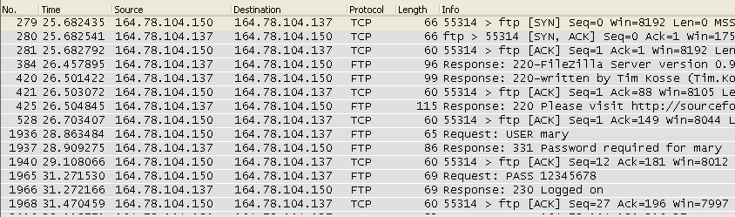
FTP Signatures
3-way handshake to set up control connection
User authentication
(username and password are sent in cleartext)

Slide 48
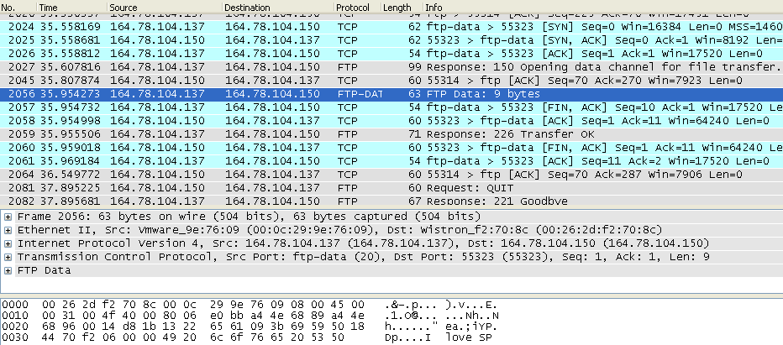
FTP Signatures
3-way handshake to set up data connection
Transfer of file
(contents of file sent in cleartext)

Slide 49
Summary
Network protocols set out rules on how devices communicate with one another
IPv4 uses 32-bit (four-byte or four octets) addresses, which limits the address space to about 4 billion addresses
IPv6 will use 128-bit addresses, which supports about 300 trillion trillion trillion addresses
ICMP assists TCP/IP networks with troubleshooting communication problems
TCP uses a 3-way handshake to establish a connection between 2 computers
HTTP used to access data on the World Wide Web
FTP for copying files between systems

